Slide 1
Diversity, Equity, and Inclusion
Dei BRANCH ASSESSMENT
Content from AAUW National DEI Tool Kit
Prepared by AAUW Missouri Diversity, Equity, and Inclusion (DEI) Committee
Notes:
As an organization, AAUW is striving for a culture of inclusiveness. An inclusive culture is a space where people with different backgrounds, origins and thought processes can work more efficiently and effectively together. When we create spaces that allow different perspectives, opinions and voices to be heard, we enable them to contribute meaningfully to the continued growth and development of our organization. To get there, we must examine how we are doing and how we set goals to help us move forward.

Slide 2
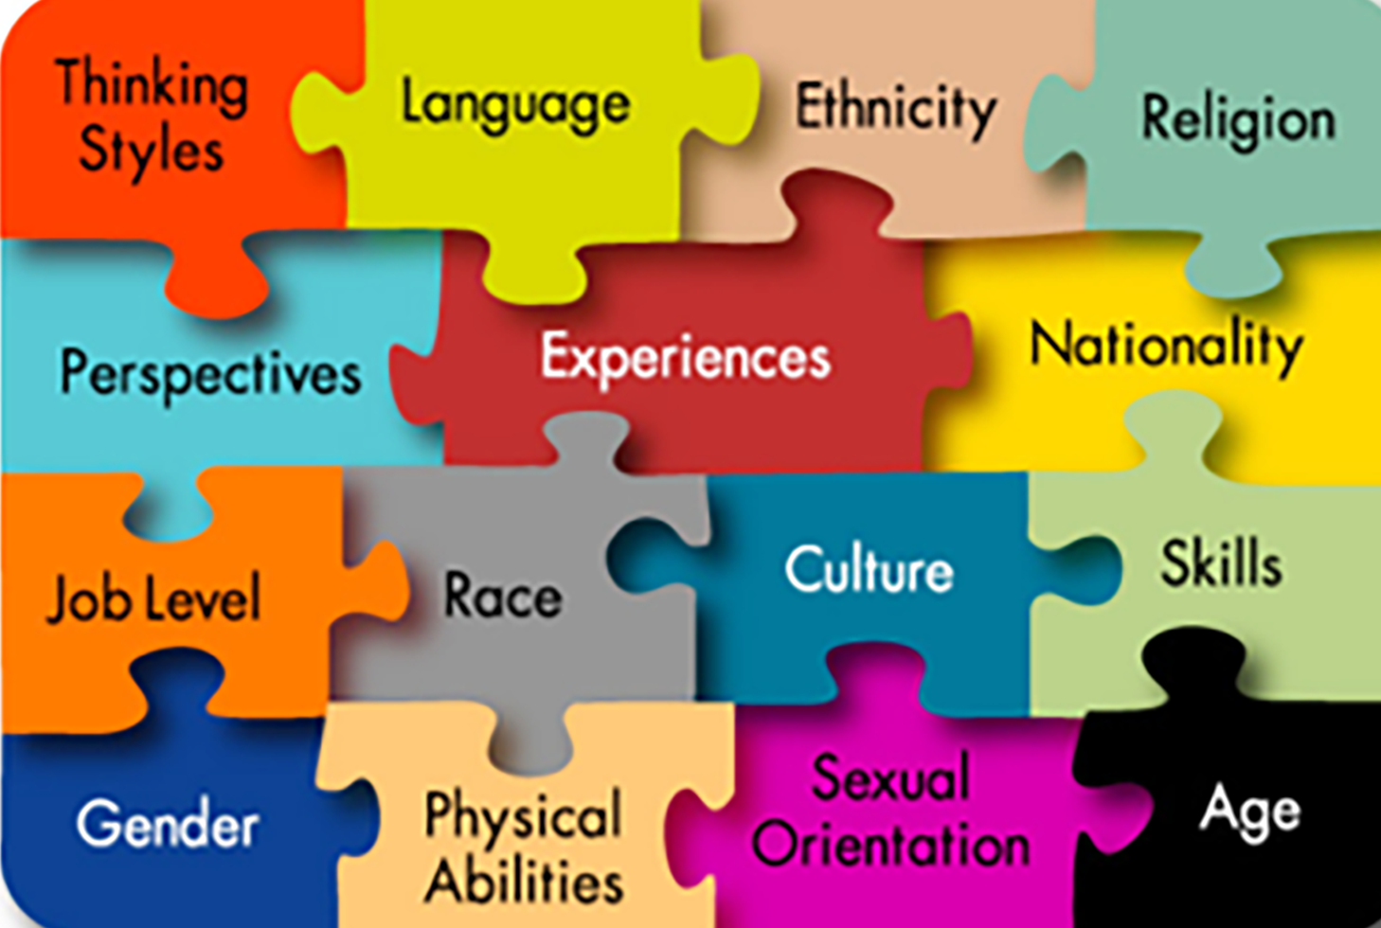

Slide 3
Diversity Structure & Planning
Appoint a Diversity Officer
Create a Diversity and Inclusion Committee (2-4)
Engage Members in Diversity and Inclusion Conversations
Use Inclusion Infusion activities at every branch board and member meetings
Assess your Branch’s Diversity and Inclusion
Create a Diversity and Inclusion Plan
Reassess your Progress and Adapt your Plan
Notes:
As an organization, AAUW is striving for a culture of inclusiveness. An inclusive culture is a space where people with different backgrounds, origins and thought processes can work more efficiently and effectively together. When we create spaces that allow different perspectives, opinions and voices to be heard, we enable them to contribute meaningfully to the continued growth and development of our organization. To get there, we must examine how we are doing and how we set goals to help us move forward.
The steps below outline the process of creating a diversity and inclusion plan. We recommend creating a diversity and inclusion plan to help shape and guide your efforts. A plan will help you ensure that your efforts are well thought-out, organized, and in alignment with the broader goals for your branch.
This process is best completed with your board or leadership to build group buy-in for carrying out the plan.
Remember that a diversity plan is meant to serve as a guide to help organize your programming and efforts to maximize the results.
Even after going through this process, you may have to adjust your plan to account for things that worked, as well as things that didn’t – and that’s okay. Treat this as a flexible rather than a rigid plan.

Slide 4
Having Difficult Conversations
Agree on Ground Rules and Post Them
Set Community Agreements
Follow Best Practices for Managing Conflict
Attempt to pursue a common goal, rather than individual goals
Openly and honestly communicate with everyone
Foster a culture in which differences of opinion are encouraged, placing emphasis on the common goals among your members
When conflict is avoided or approached on a win/lose basis, it becomes unhealthy and can cause low morale and increased tension within your members
Notes:
You need to agree on certain ground rules and promise to honor and respect everyone’s thoughts, ideas and opinions for the duration of each session. It’s important to ensure that everyone feels safe for conversation and exploration.
Ground Rules
Listen actively — respect others when they are talking.
Speak from your own experience instead of generalizing (“I” instead of “they,” “we,” and “you”).
Do not be afraid to respectfully challenge one another by asking questions but refrain from personal attacks — focus on ideas.
Participate to the fullest of your ability — community growth depends on the inclusion of every individual voice.
Instead of invalidating somebody else’s story with your own spin on her or his experience, share your own story and experience.
The goal is not to agree — it is to gain a deeper understanding.
Be conscious of body language and nonverbal responses: They can be as disrespectful as words.
Ground rules may also include participation-management techniques. Do group members want to be called on or would they like to speak freely? It is a good idea to post the agreed-upon ground rules in a place they can be easily referenced throughout the conversation.
Start each activity or discussion by setting community agreements.
*Speak from the “I” perspective: Avoid speaking for others by using “we,” “us,” or “them.”
Listen actively: Listen to understand, not to respond. Sometimes we are tempted to begin formulating what we want to say in response, instead of giving 100 percent of our focus to the speaker. So let’s make sure we are listening 100 percent.
Step up, step back: If you usually speak up often or you find yourself talking more than others, challenge yourself to lean in to listening and opening up space for others. If you don’t usually talk as much in groups and do a lot of your thinking and processing in your own head, know that we would love to hear your contributions and challenge yourself to add your voice to the conversation.
Respect silence: Don’t force yourself to fill silence. Silence can be an indication of thought and process.
Share, even if you don’t have the right words: Suspend judgment and allow others to be unpolished in their speaking. If you are unsure of their meaning, ask for clarification.
Uphold confidentiality: Treat the candor of others as a gift. Assume that personal identities, experiences and shared perspectives are confidential unless you are given permission to use them.
Lean into discomfort: Learning happens on the edge of our comfort zones. Push yourself to be open to new ideas and experiences even if they initially seem uncomfortable to you.

Slide 5
Ground Rules
Listen actively — respect others when they are talking.
Speak from your own experience instead of generalizing (“I” instead of “they,” “we,” and “you”).
Do not be afraid to respectfully challenge one another by asking questions but refrain from personal attacks — focus on ideas.
Participate to the fullest of your ability — community growth depends on the inclusion of every individual voice.
Instead of invalidating somebody else’s story with your own spin on her or his experience, share your own story and experience.
The goal is not to agree — it is to gain a deeper understanding.
Be conscious of body language and nonverbal responses: They can be as disrespectful as words.

Slide 6
Understand Your Conflict Resolution Style
Notes:
The five styles are:
Collaborating Style
Competing Style
Avoiding Style
Accommodating Style
Compromising Style
The more assertive and less cooperative you are, the more likely you are to exhibit traits of the competing style for managing conflict, and the more cooperative and less assertive you are, the more accommodating you are in your style of conflict management.

Slide 7
Stages of Inclusiveness
Notes:
As an organization, AAUW is striving for a culture of inclusiveness. An inclusive culture is a space where people with different backgrounds, origins and thought processes can work more efficiently and effectively together. When we create spaces that allow different perspectives, opinions and voices to be heard, we enable them to contribute meaningfully to the continued growth and development of our organization. To get there, we must examine how we are doing and how we set goals to help us move forward.
Pass out the Organizational Inclusiveness Stages handout..

Slide 8
Examine Your Current Progress
Recruitment
How do we currently recruit new members?
What are the typical identities of the people we recruit?
Retention
What do we do to welcome new people to our branch?
Who stays and who does not return?
Why do you think that is?
What is the identity makeup of our branch?
Notes:
Lead a discussion with the group about your current work in each of the categories below. Use the sample questions to prompt the discussion. This will help you identify the stage you are currently in. As you move through each category, record answers on a flip chart or a Word document projected onto a screen.
Recruitment
How do we currently recruit new members?
What are the typical identities of the people we recruit?
Retention
What do we do to welcome new people to our branch?
Who stays and who does not return?
Why do you think that is?
What is the identity makeup of our branch?

Slide 9
Examine Your Current Progress
Programming
Who is our programming intended for?
Who does our current programming typically attract?
Why do we think that is?
How accessible are our programs in terms of location, date and time and more?
Communication
What methods do we use to communicate upcoming programs and news for our branch?
Who uses or does not use these methods?
What methods are we not using?
Notes:
Lead a discussion with the group about your current work in each of the categories below. Use the sample questions to prompt the discussion. This will help you identify the stage you are currently in. As you move through each category, record answers on a flip chart or a Word document projected onto a screen.
Programming
Who is our programming intended for?
Who does our current programming typically attract?
Why do we think that is?
How accessible are our programs in terms of location, date and time and more?
Communication
What methods do we use to communicate upcoming programs and news for our branch?
Who uses or does not use these methods?
What methods are we not using?

Slide 10
Examine Your Current Progress
Leadership Development/Succession
How do we get new board members?
What do we do to encourage and support members to become leaders?
Who do we encourage, and who do we not encourage?
What is the makeup of our leadership?
Does our leadership reflect the diversity of our branch?
Planning and Decision Making
Who is involved in planning for our branch?
What does the process entail?
How transparent is this process?
What methods are we not using?
Notes:
Lead a discussion with the group about your current work in each of the categories below. Use the sample questions to prompt the discussion. This will help you identify the stage you are currently in. As you move through each category, record answers on a flip chart or a Word document projected onto a screen.
Leadership development/succession
How do we get new board members?
What do we do to encourage and support members to become leaders?
Who do we encourage, and who do we not encourage?
What is the makeup of our leadership?
Does our leadership reflect the diversity of our branch?
Planning and decision making
Who is involved in planning for our branch?
What does the process entail?
How transparent is this process?

Slide 11
Gather Your Membership Information
In the last two calendar years, have you actively recruited new members?
How many new members have you recruited in that timeframe?
What is the current demographic makeup of your membership? Of your leadership?
What is the retention rate of members? Do you know why members who were not retained left?
What’s been working in helping to create an inclusive environment?

Slide 12
Gather Your Program Information
What types of programs has your branch organized in the past two years?
Who was the target audience? What was the goal of the program?
How is diversity incorporated into the program calendar?
What has been your branch’s strategy for reaching a broader audience?

Slide 13
Moving Forward
Determine Your Stage
Create an Action Plan with SMART Goals
Put into Action Your Next Steps
Notes:
“If we want to move forward on this continuum, what do we need to do differently in each of these categories?”
Return to each category discussed in step three of this exercise and brainstorm clear, actionable changes that your branch can implement to become more inclusive.

Slide 14
SMART Goal Setting
SMART is an acronym that you can use to guide your goal setting.
To make sure your goals are clear and reachable, each one should be:
Specific
Measurable
Achievable
Relevant
Time Sensitive

Slide 15
Branch Activities (Plug ‘n Play)
Understanding the Difference Between Diversity, Equity & Inclusion (DEI)
Diversity vs. Inclusion
Inclusion vs. Belonging
Equity vs. Equality
Understanding Unconscious Bias
Recognizing unconscious bias in themselves
Recognizing unconscious bias in others
Addressing unconscious bias
Notes:
Each Plug and Play topic includes an explanation of the topic, guidelines for the facilitator(s), and discussion prompts to make the event and conversation as robust as possible.
We strongly encourage all branches to have created their diversity plan using the Diversity Planning and Structure exercise before engaging in the plug and play programs. Having a plan in place first will help ensure that your programming is aimed at helping your branch achieve its equity and inclusion goals.

Slide 16
Lead Your Branch
Attend National DEI Webinars
Complete a branch assessment
Start branch meetings with 10 minutes of Inclusion – Infusion
Include DEI articles in branch newsletters
Plan programs to introduce DEI to the branch
Include DEI in book group selections
Have a Lunch & Learn with 1 topic / month
Notes:
As an organization, AAUW is striving for a culture of inclusiveness. An inclusive culture is a space where people with different backgrounds, origins and thought processes can work more efficiently and effectively together. When we create spaces that allow different perspectives, opinions and voices to be heard, we enable them to contribute meaningfully to the continued growth and development of our organization. To get there, we must examine how we are doing and how we set goals to help us move forward.
The steps below outline the process of creating a diversity and inclusion plan. We recommend creating a diversity and inclusion plan to help shape and guide your efforts. A plan will help you ensure that your efforts are well thought-out, organized, and in alignment with the broader goals for your branch.
This process is best completed with your board or leadership to build group buy-in for carrying out the plan.
Remember that a diversity plan is meant to serve as a guide to help organize your programming and efforts to maximize the results.
Even after going through this process, you may have to adjust your plan to account for things that worked, as well as things that didn’t – and that’s okay. Treat this as a flexible rather than a rigid plan.

Slide 17
Actions for Reaching a More Diverse Audience
How will your branch make this happen?

