Slide 1
Diversity, Equity, and Inclusion
GLOSSARY
Content from AAUW National DEI Tool Kit
Prepared by AAUW Missouri Diversity, Equity, and Inclusion (DEI) Committee
Notes:
The terms cut across all facets of life — from access to education, to fairness in pay and salaries, to career advancement, and even homeownership.
But what exactly do we mean when we say diversity, equity and inclusion?
When discussing issues of diversity, equity and inclusion, it is important to understand the nuances of the language we use.
As an organization, we are realistic: We don’t expect all our members to read a few definitions and become experts in diversity, equity, and inclusion.
This is a starting point.
We hope to help build your diversity knowledge, equip you with the right tools and develop the capabilities to implement these actions.
AAUW’s goal is for members to understand what is meant by equity.

Slide 2
Diversity
The condition of having or being composed of differing elements
Variety
The inclusion of different types of people in a group or organization programs intended to promote diversity
Notes:
Failing to incorporate diversity into what AAUW does – not just our membership, but throughout the organization – and aligning it to our organizational mission and goals can cause a catastrophic error, from which we may not be able to recover.
Diversity in volunteering provides many advantages including:
--The creation of a more positive and inclusive image
--Being representative of the wider community by the involvement of volunteers from different backgrounds
--Being more able to understand and respond to the needs of your local community
--New ideas and fresh approaches generated by people from different backgrounds and with different outlooks
--A broader range of skills and abilities
--Helping your volunteers to be role models which will encourage others from similar groups to volunteer and help increase their aspirations
--More confidence in working with people from different backgrounds
--Eligibility for wider sources of funding

Slide 3
Diversity
Includes everyone — young and old, homeless and affluent, immigrant and native, white and black, rural and urban, gang member and corporate professional
Characteristics that make each of us unique
Is not about “them” — it is about each person coming to terms with his or her attitudes, beliefs and experiences about others and gaining comfort with differences
Notes:
Recognizing what makes us different and unique is important and, without taking diversity into consideration, we run the risk of excluding some individuals.
Being unique is important.

Slide 4
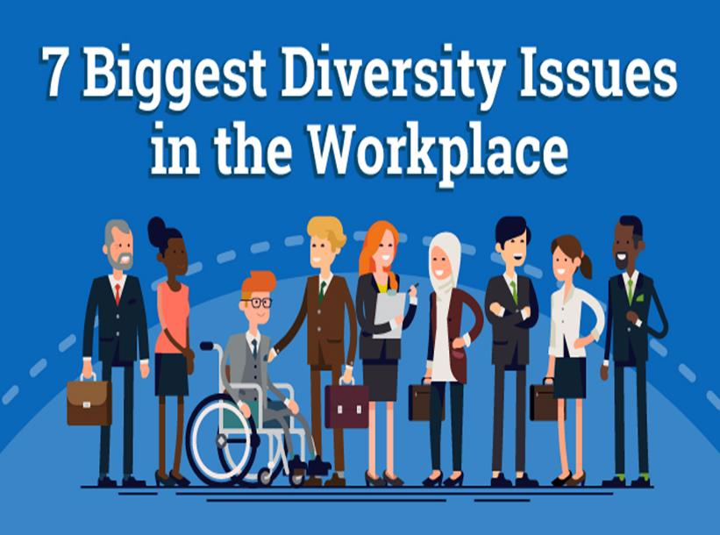
Diversity isn’t just black and white
Gender Equality
Age / Generation Gaps
Language / Communication
Race / National Origin
Religious Beliefs
Physical Ability / Disability
Ethnic / Cultural Differences
Notes:
People find comfort in likeness. We have a tendency to seek the company of those most similar to us in a variety of ways . . . age, gender and ethnicity being just a few.
7 Biggest Diversity Issues in The Workplace
Acceptance and Respect. ...
Accommodation of Beliefs. ...
Ethnic and Cultural Differences. ...
Gender Equality at the workplace is yet to go mainstream. ...
Physical and Mental Disabilities. ...
Generation Gaps. ...
Language and Communication.
____________________________________________
8 Strategies For Creating A More Inclusive Volunteer Program -- 8 Strategies For Creating A More Inclusive Volunteer Program
Strategy #1: Shift Your Language. ...
Strategy #2: Build Relationships. ...
Strategy #3: Understand The Importance Of Socio-Economic Status. ...
Strategy #4: Embrace Skills-Based Opportunities. ...
Strategy #5: Recruit From Those Who Use Your Services
Strategy #6: Partner To Engage Groups Of Youth (for volunteer services on projects)
Strategy #7: Remove Barriers (such as required background checks, strict requirements that are hard for low-income people to meet)
Strategy #8: Create an Inclusive Organizational Culture
when it comes to workplaces, there are 7 primary types of diversity we can see (source: https://blog.vantagecircle.com/types-of-diversity/)
Race and Ethnicity. ...
Age and Generation. ...
Gender and Gender Identity. ...
Sexual Orientation. ...
Religious and Spiritual Beliefs. ...
Disability. ...
Socioeconomic Status and Background.
Top Challenges of Diversity in the Workplace—And How to Address Them
Communication issues. ...
Cultural misunderstandings. ...
Slower decision making. ...
Inequitable inclusion. ...
Discrimination. ...
Final thoughts on the challenges of diversity in the workplace.

Slide 5
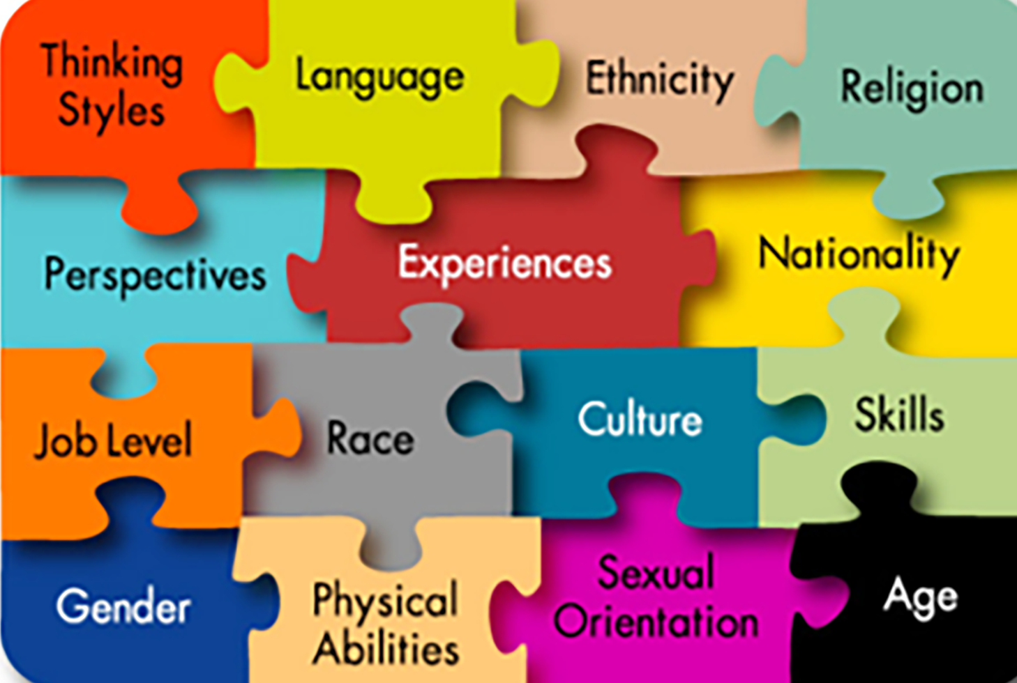

Slide 6
Diversity . . .
Brings in new ideas and experiences
Helps people learn from each other
Brings in different ideas and perspectives which leads to better problem-solving
Opens dialogue and promotes creativity
Notes:
Diversity can be a great source of strength.
The beauty of diversity — and what makes it so powerful — is learning to appreciate it and creating an environment where it can grow and thrive.
We strive to create an environment where we can explore our differences in a safe and respectful way that helps each person understand their value and celebrates what diversity brings to AAUW.

Slide 8
Equity
Justice according to natural law or right specifically
Freedom from bias or favoritism
Something that is equitable

Slide 9
Equality vs Equity
Equality -- everyone has the same access to — or amount of — something
Equity -- everyone has equal access to what they need to accomplish the same outcome
Which is fair?
Notes:
Although these two words have the same root, they don’t mean the same thing.
They are often used interchangeably, even though they differ in meaning.

Slide 10
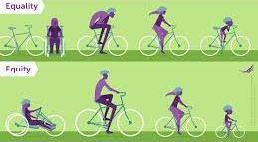
Equality vs Equity

Slide 11
Why Promote Equity?
AAUW is the nation’s premier organization:
Fighting for gender equity
Advocating to narrow the pay gap for women
Championing equal opportunity for women in education
Working together to support laws and policies that enable women’s success
Notes:
Even with all our understanding, there’s still something we can learn.

Slide 12
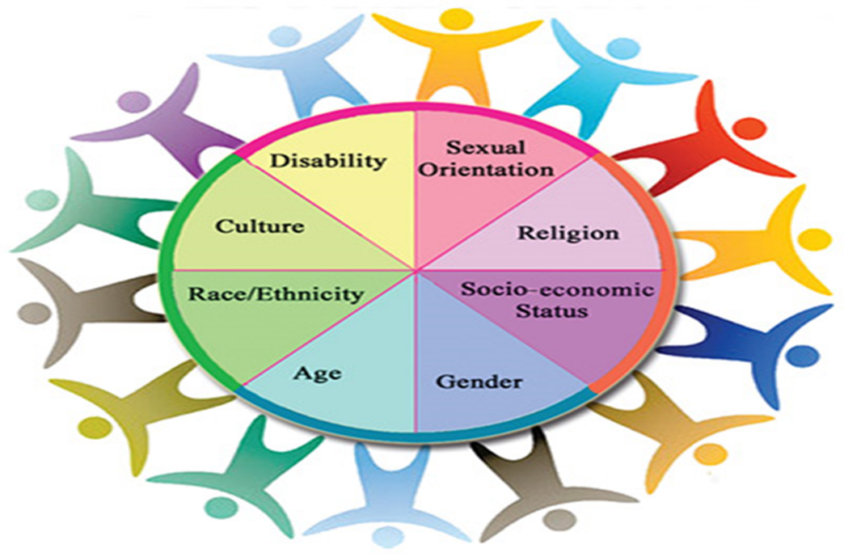
Equality is the end goal.
Equity is the means to get there.
Notes:
We all should know that diversity makes for a rich tapestry and that all the threads are equal in value. Maya Angelo

Slide 14
Inclusion
The act of including
The state of being included
The act or practice of including and accommodating people who have historically been excluded (because of their race, gender, sexuality, age, education, nationality, disability, or ability)

Slide 15
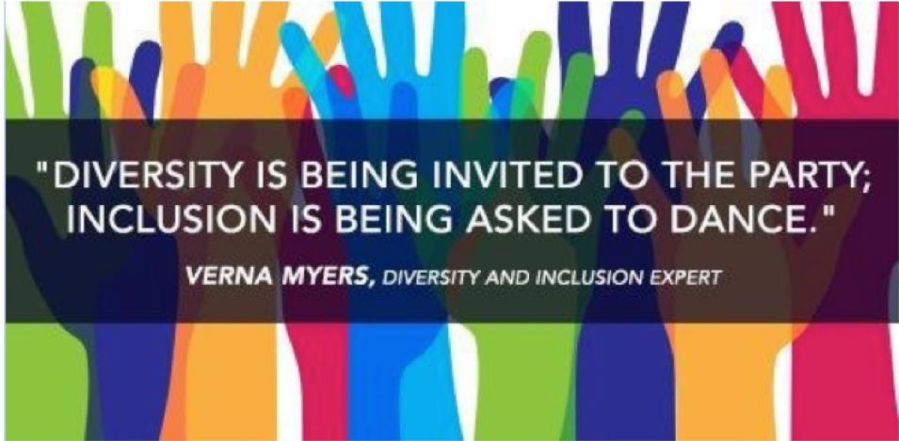
Why Inclusion?
To be truly diverse, groups need
to be inclusive
to provide people with full access to resources
to enable people to participate fully toward the group’s success
Notes:
Inclusion = behaviors and actions
To be truly inclusive, we often have to change the culture — and culture shifts can make people uncomfortable or give the sense that they are losing something. But that is absolutely not the case. In fact, the exact opposite is true: Research suggests that in environments where people feel supported, welcomed, respected and valued are actually more productive; everyone feels a greater connection to the organization’s mission.
Diversity is only the beginning, and it isn’t enough.

Slide 16
A Culture of Belonging
People feel like they are part of something, that they matter, or that they are needed
People who feel welcomed, appreciated, respected, and valued
are more productive
feel a greater connection to the organization’s mission
Notes:
So, if diversity means the characteristics that make us unique, and inclusion refers to behaviors and actions, then what is belonging?
AAUW needs all of these things together — diversity, inclusion, and belonging — for our branches to continue to grow and thrive.

Slide 17
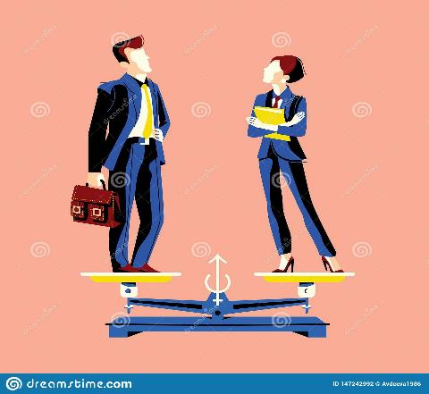
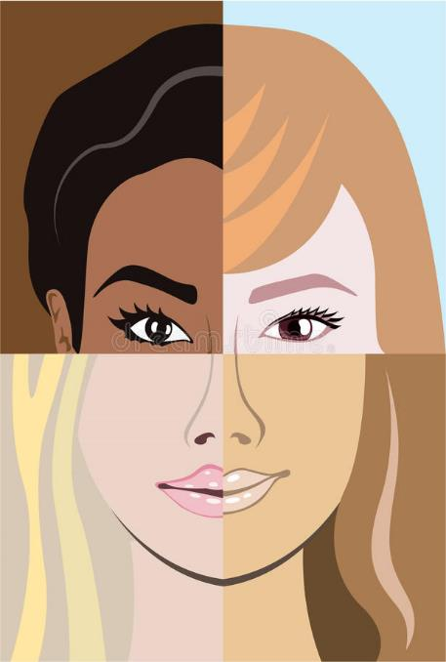
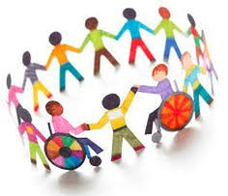
AAUW needs diversity, equity, inclusion, and belonging for our members to feel more connected to our mission and be more productive.
Notes:
We all should know that diversity makes for a rich tapestry and that all the threads are equal in value. Maya Angelo
Equality is simply making accommodations available to those who qualify. Equity refers to the specific things each person needs to succeed. As an example, a person might ask to work from home a few days a week because of a medical condition. Providing the option to work remotely allows them to fulfill their full potential at their job. Not everyone will require the same accommodations while some may need more than others. Equity is based on specific, individual needs, but equality is the desired outcome.
https://www.humanrightscareers.com/issues/examples-of-equality-and-equity-in-the-workplace/

Slide 18
Stronger Together as we advocate for women and girls

Slide 19
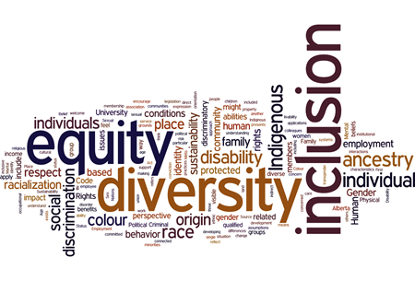
belonging

